Slide 1
Biodiversity Slide Deck
A Codecademy Slide Deck by Michael Tariku

Slide 2
Species Data - Contents
This dataset contains over 5,000 species and their conservation statuses, if applicable
Each species belongs to one of seven categories: Mammal, Bird, Fish, Amphibian, Reptile, Non-vascular Plant, and Vascular Plant
Scientific names correspond to one (or multiple) common names -- it is surmised that multiple common names for species are what they are called in different parks
However, this dataset alone does not tell one what names species with multiple common names are called

Slide 3
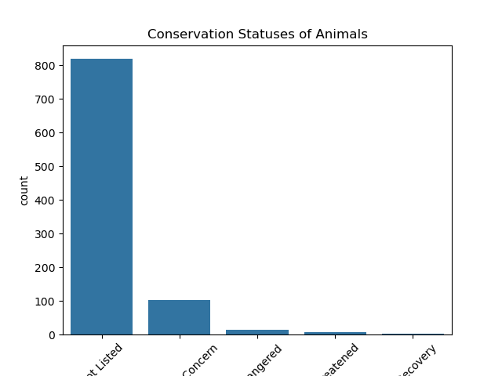
Species Data: Conservation Status
Notes:
The majority of species do not have a documented conservation status (e.g. ‘Endangered’, ‘Threatened’, ‘Species Of Concern’). As such, I kept these species by giving them a new designation -- ‘Not Listed’.

Slide 4
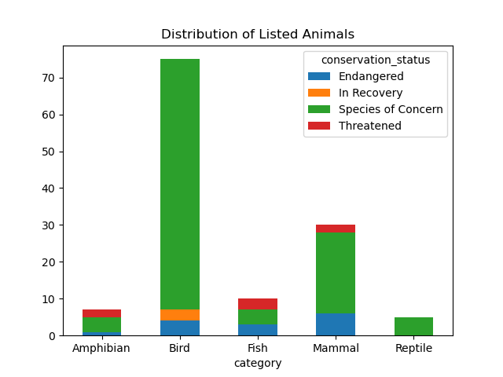
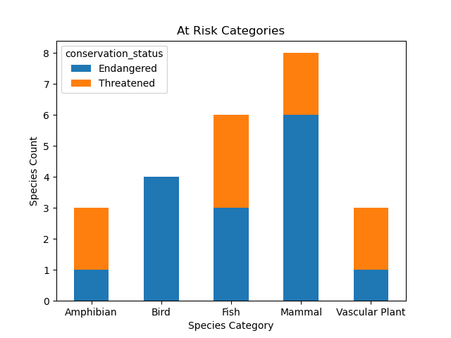
Species Data: Species At Risk
Notes:
These graphs side by side tell a story of which animals are most at risk.
Not only are there more birds in the ‘Species of Concern’ category, but all endangered birds are at risk of extinction. However, there are also more birds in the ‘In Recovery’ category than any other animal, suggesting things are improving in certain parks for certain avian species.
All reptiles are in concern, but none are threatened or endangered. However, this does not guarantee that they are safe from harm.
More mammals are endangered than any other kind of animal, and they come in second in the ‘Species of Concern’ category.

Slide 5
Species Data: Statistical Significance
Null hypothesis: whether a species is a plant or animal has no effect on whether it is at risk (i.e. endangered or threatened)
The corresponding contingency table:
Resulting p-value: 4.764995109047095e-19
 | NOT AT RISK | AT RISK
ANIMAL | 925 | 21
PLANT | 4,592 | 3
Notes:
Because the p-value is significantly less than 0.05, we can reject the null hypothesis; there is a strong relationship between the type of species and its at-risk status.
In fact, plants are proportionately more likely to be classified as not at risk than animals. However, because an earlier graph revealed most species were not listed, 'not at risk' does not necessarily mean plants are safe.

Slide 6
Observations Data: Contents
This dataset contains recorded sightings of over 23,000 species in four national parks over the past week
The number of species counted in each park is given in the observations column; although this alone is not a clear metric of biodiversity, it could say something about park size and sampling effort

Slide 7
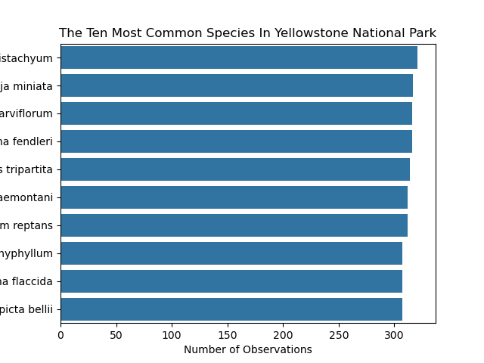
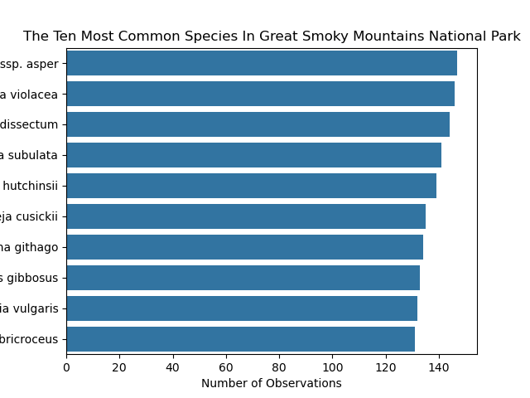
Observations Data: Most Common Species by Park
Notes:
Both graphs show the top ten most common species in each park.
At a glance, Yellowstone National Park has the highest observed number of species while Great Smoky Mountains National Park has the least.

